Slide 1

Simple farmers portal

Slide 2
Problem Statement
Develop a website to assist the farmers in one platform.

Slide 3
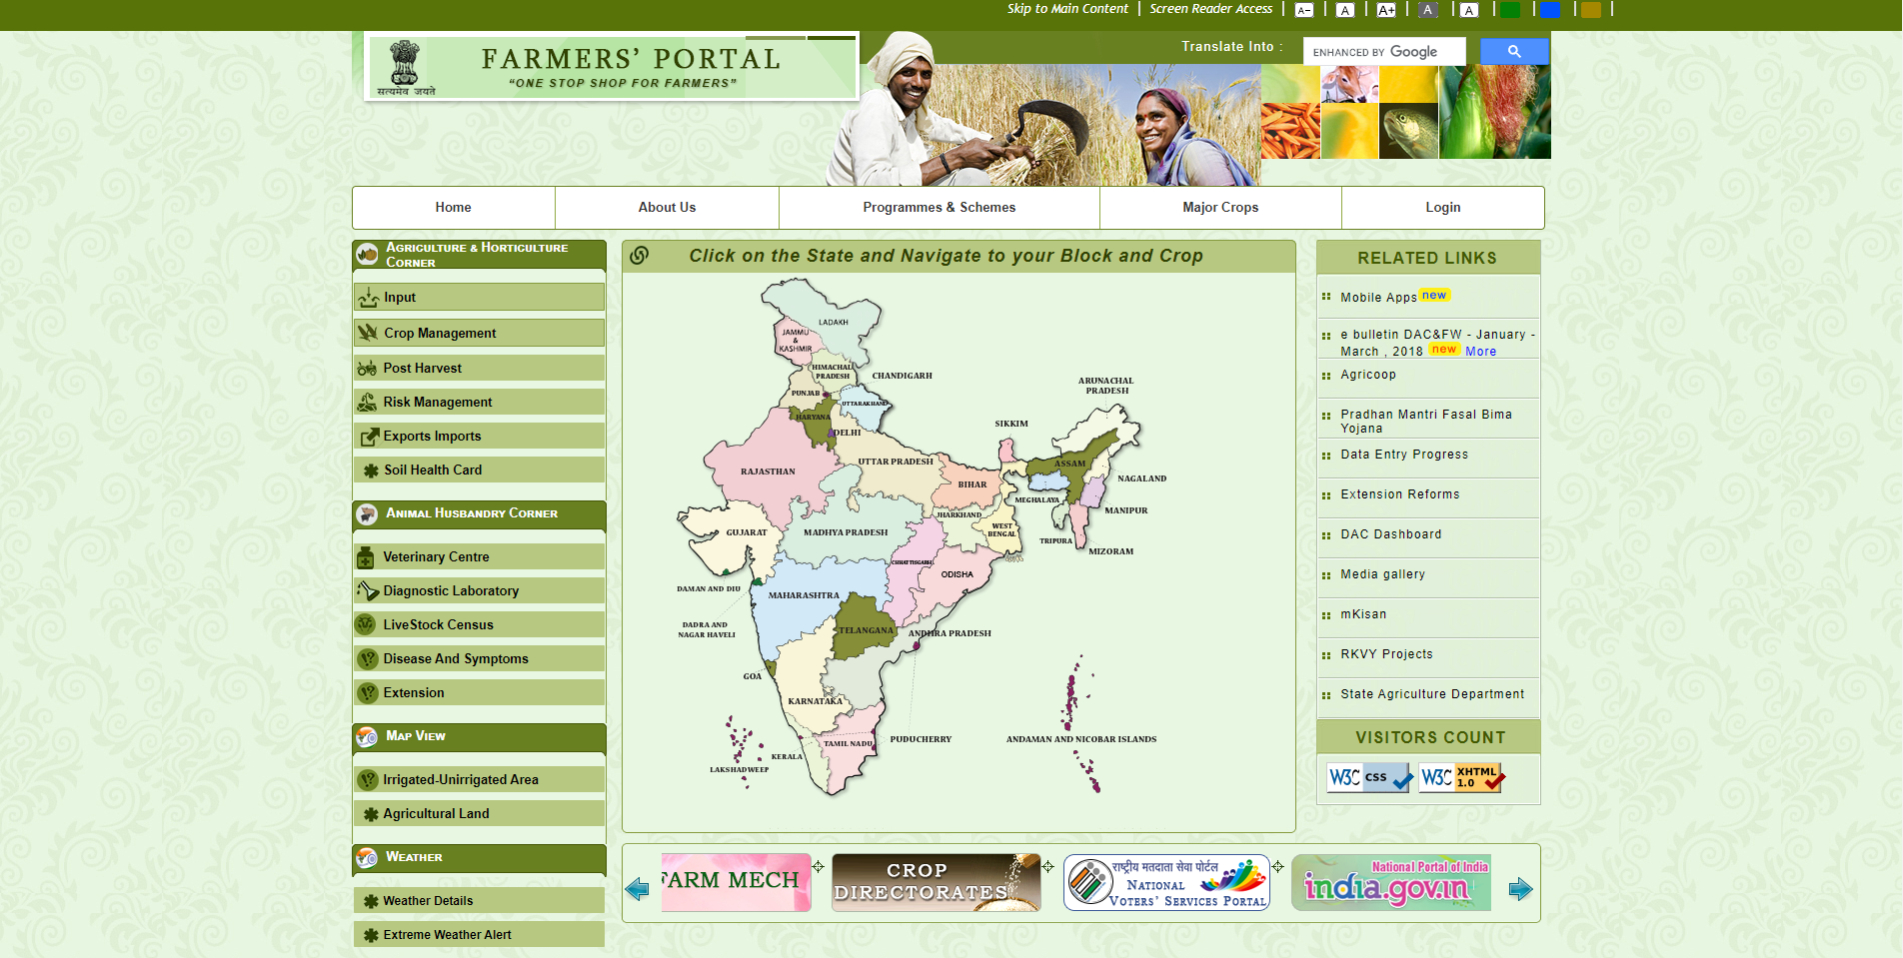
Existing Work
https://farmer.gov.in

Slide 4
Existing Work(limitations)
https://farmer.gov.in
Due to spotty network conditions in rural areas, heavy websites tend to load slow or fail to load completely.
Also farmers are generally not equipped with technical knowledge to use complex websites.

Slide 5
Existing Work(limitations)
https://farmer.gov.in
Farmers in rural areas are more comfortable and read & write in their regional language.
No proper support for regional languages.

Slide 6
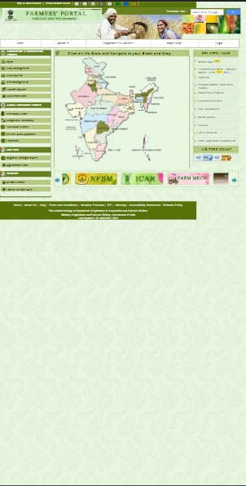
Existing Work(limitations)
https://farmer.gov.in
Today visiting websites from mobile devices is easy and more convenient
Made for landscape devices and does not render properly on mobile devices.

Slide 7
Existing Work(limitations)
https://farmer.gov.in
When designing a website targeted for farmers we must consider factors like literacy.
No proper support for accessibility features.

Slide 8
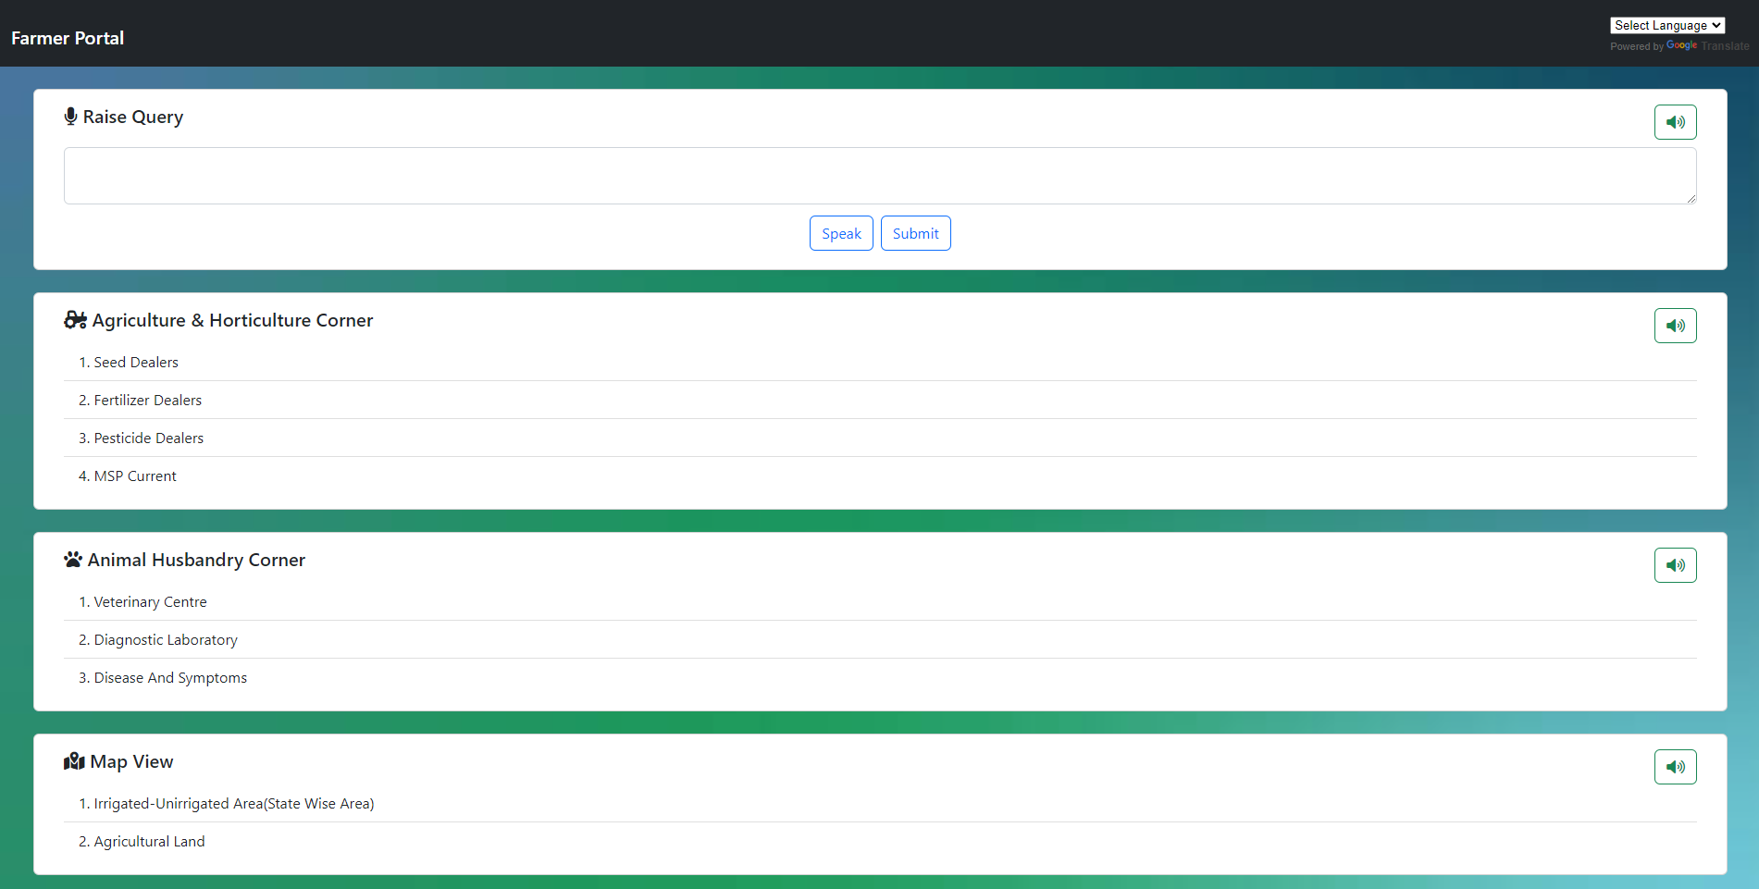
Solution
Lightweight website with simple user interface.

Slide 9
Solution
Accessibility features.
Uses google translate API for multi language support.
Text to speech in regional language.
Speech Recognition using webkitspeachrecognition

Slide 10
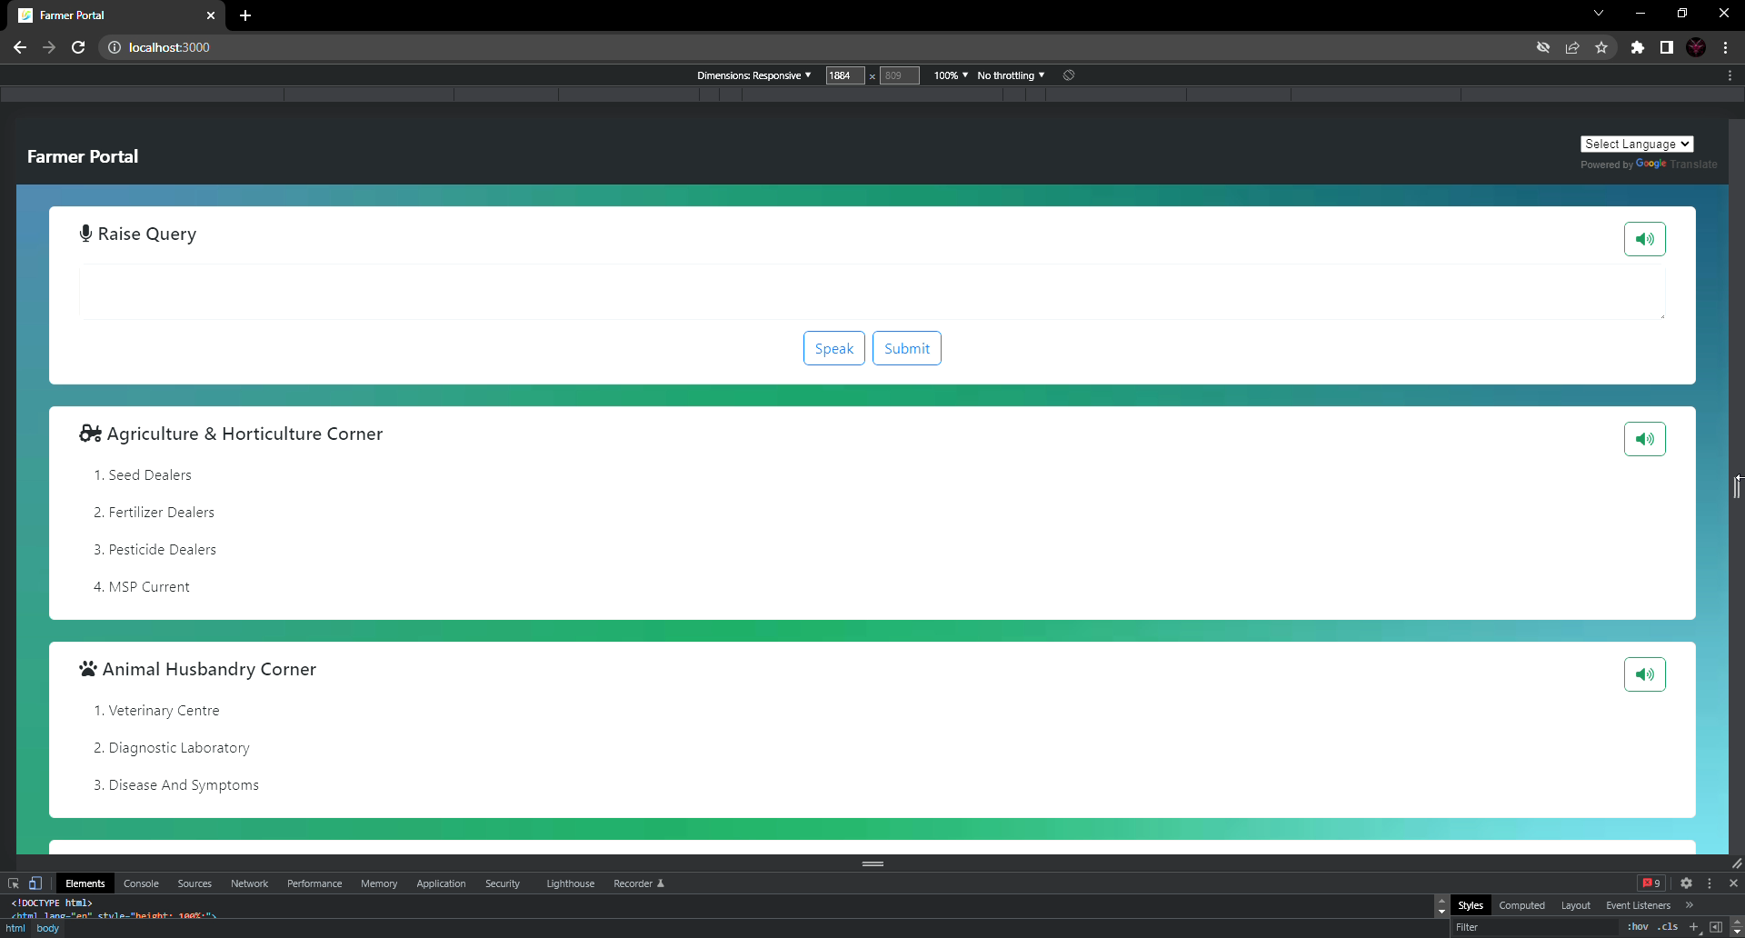
Solution
Responsive mobile first design.

Slide 11
Thank you

